Slide 1
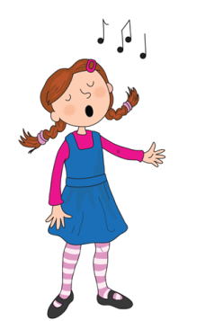
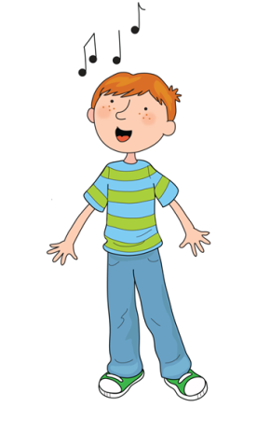
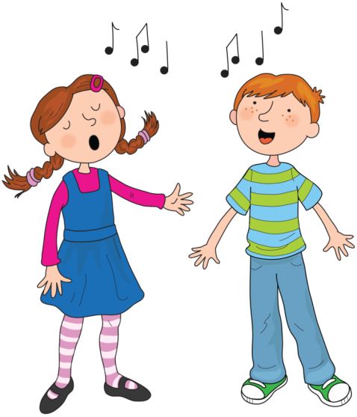
Song of Sounds

Slide 2
We can sing a song of sounds, skip to my lou my darling

Slide 3
Train in the rain ai ai ai

Slide 4
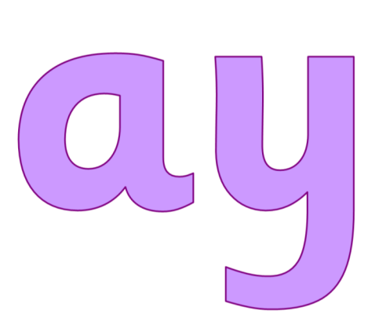
May I play ay ay ay

Slide 5
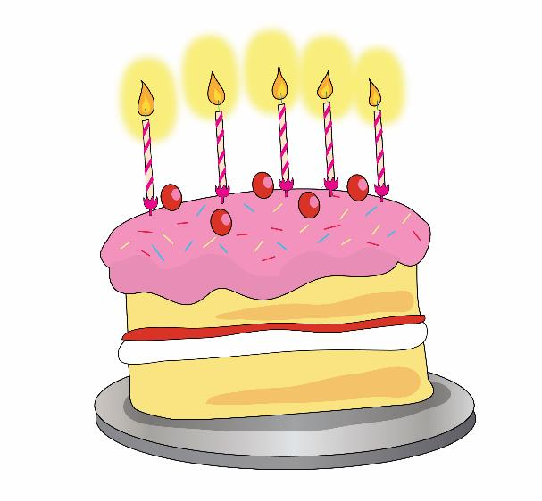
Bake a cake a-e a-e a-e

Slide 6
Skip to my lou my darling

Slide 7
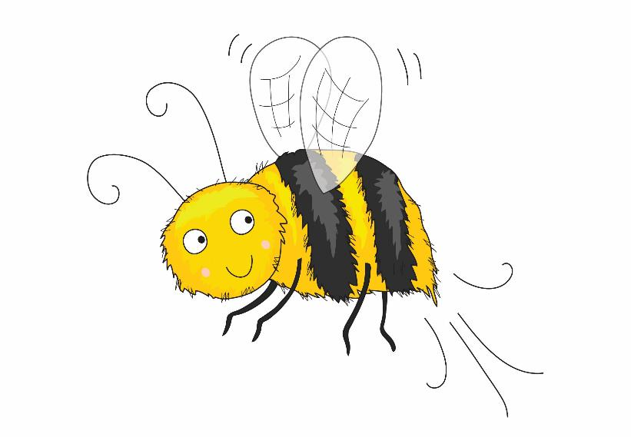
Busy busy bee ee ee ee

Slide 8
Beans in your dreams ea ea ea

Slide 9
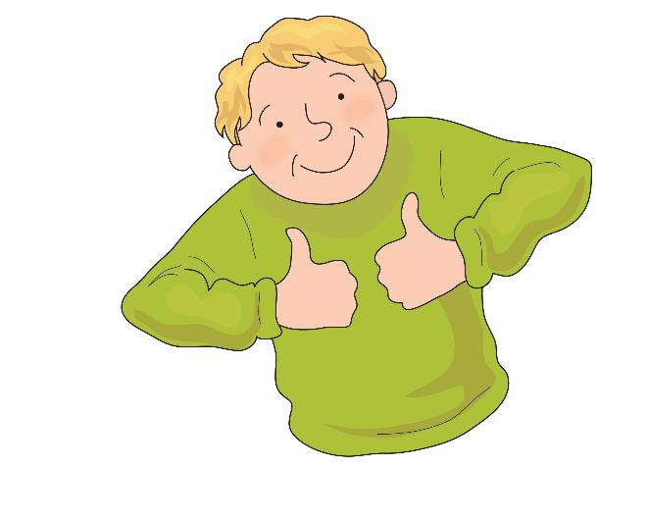
Perfect Pete e-e e-e e-e

Slide 10
Skip to my lou my darling

Slide 11
Soar up high igh igh

Slide 12
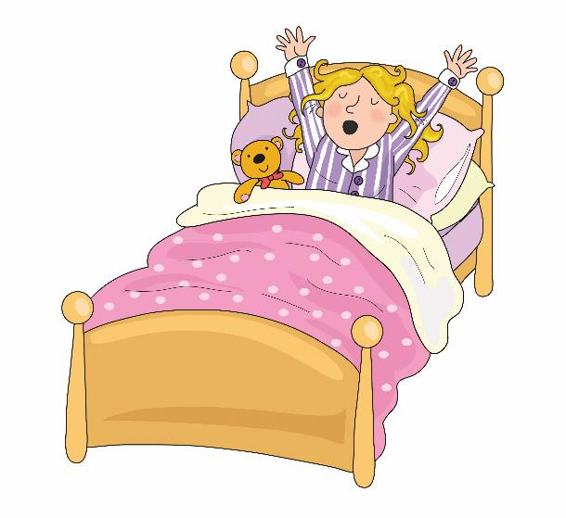
Lazy lie in ie ie ie

Slide 13
In a while crocodile i-e i-e i-e

Slide 14
Skip to my lou my darling

Slide 15
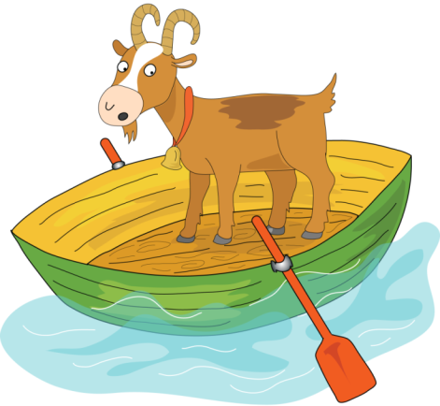
Goat on a boat oa oa oa

Slide 16
Throw the snow ow ow ow

Slide 17
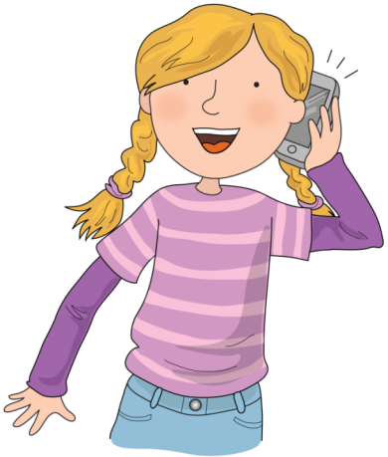
Phone home o-e o-e o-e

Slide 18
Skip to my lou my darling

Slide 19
Zoom to the moon oo oo oo

Slide 20
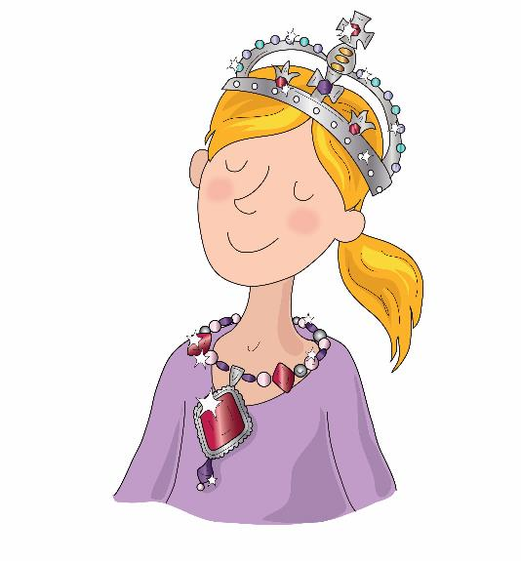
New jewels ew ew ew

Slide 21
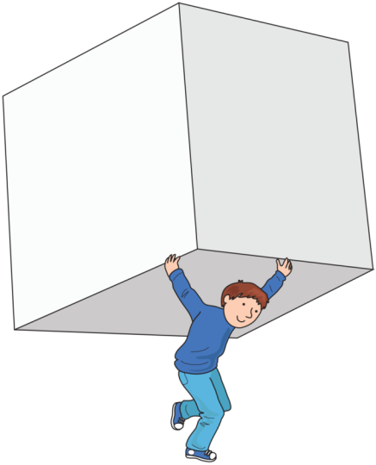
A huge cube u-e u-e u-e

Slide 22
Skip to my lou my darling

Slide 23
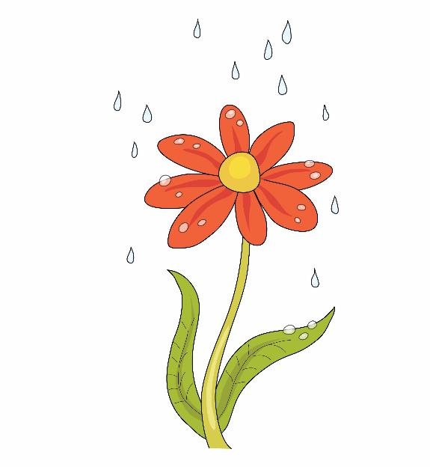
Flower in a shower er er er

Slide 24
If you’re hurt see a nurse ur ur ur

Slide 25
Girl in a whirl ir ir ir

Slide 26
Skip to my lou my darling

Slide 27
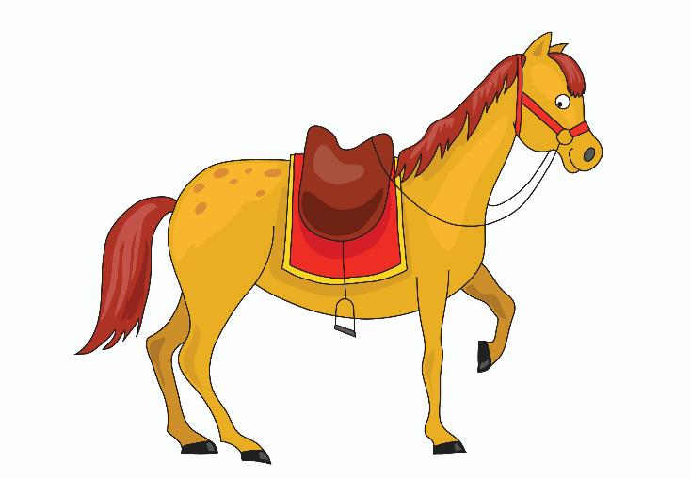
It’s a horse of course or or or

Slide 28
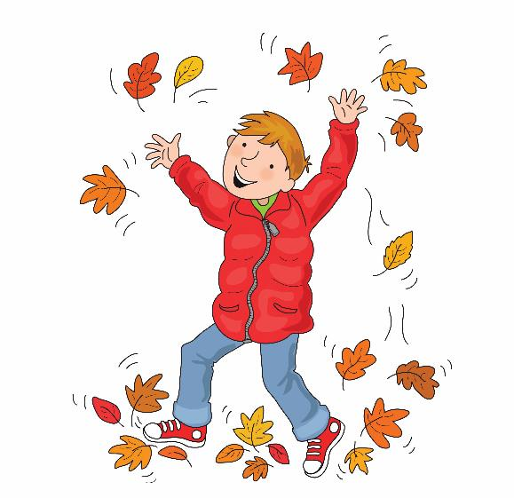
Naughty in autumn au au au

Slide 29
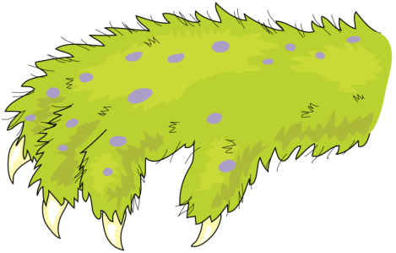
It’s an awful claw aw aw aw

Slide 30
Skip to my lou my darling

Slide 31
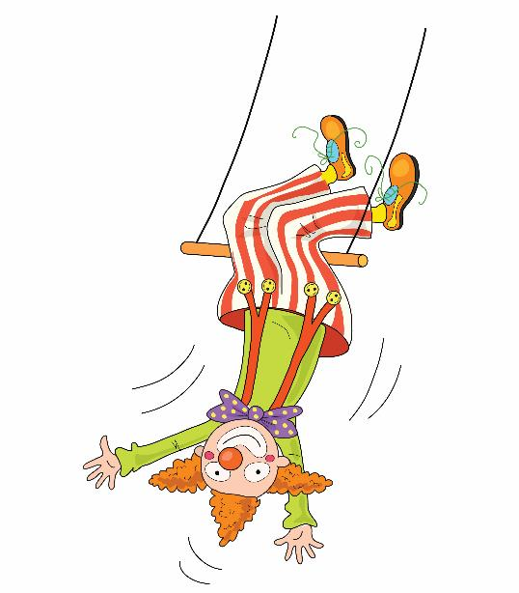
Clown upside down ow ow ow

Slide 32
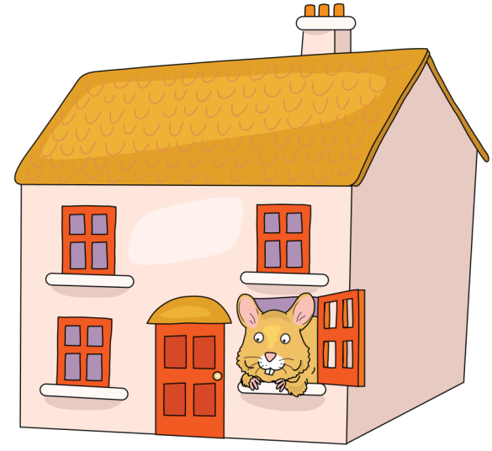
Mouse in a house ou ou ou

Slide 33
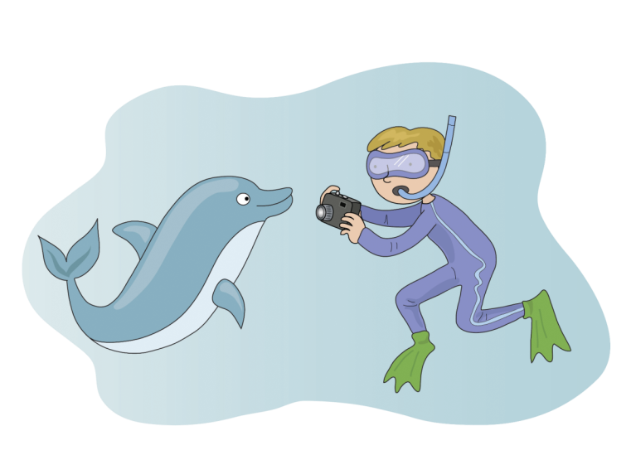
Photograph a dolphin ph ph ph

Slide 34
Skip to my lou my darling

Slide 35
Don’t be noisy oi oi oi

Slide 36
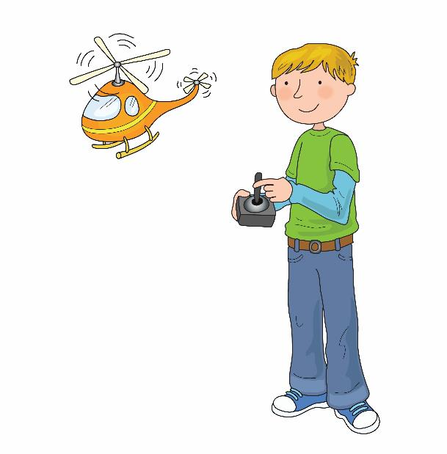
Boy with a toy oy oy oy

Slide 37
What where and when wh wh wh

Slide 38
Skip to my lou my darling

Slide 39
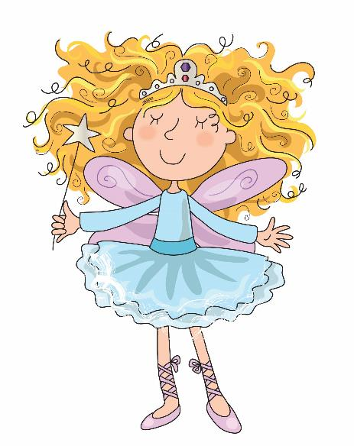
Hairy fairy air air air

Slide 40
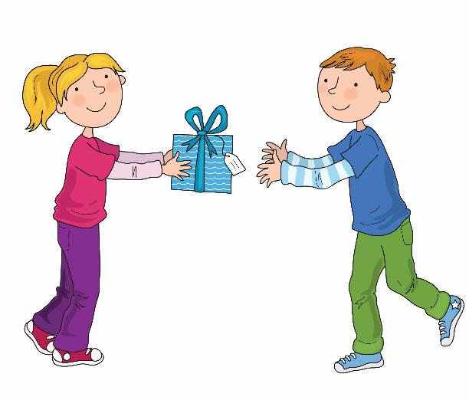
Share if you care are are are

Slide 41
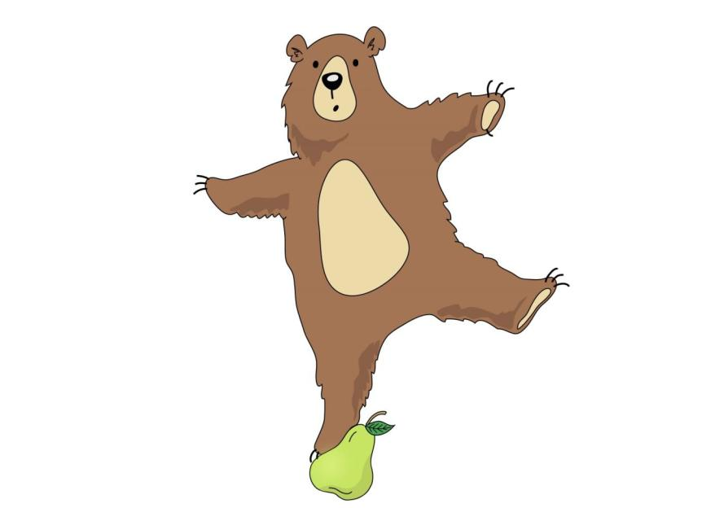
Bear on a pear ear ear ear

Slide 42
Skip to my lou my darling

Slide 43
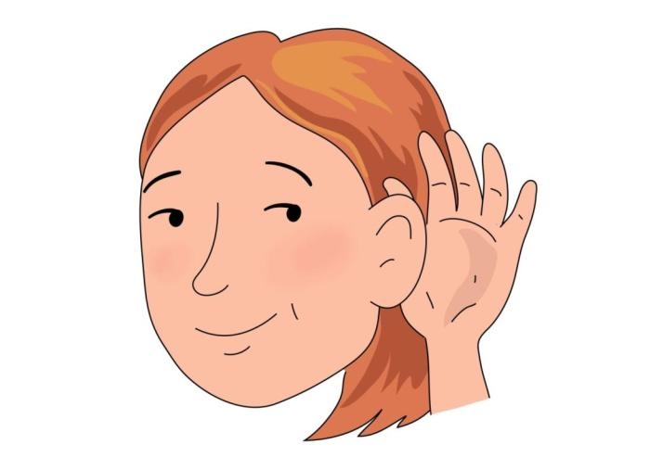
Hear with your ear
ear ear ear

Slide 44
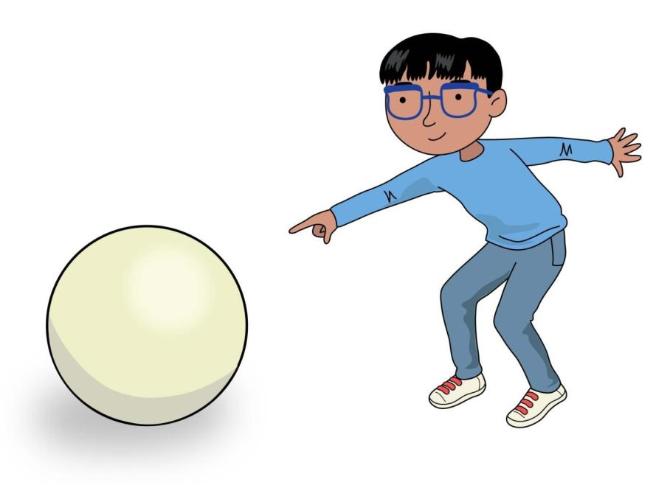
Look here it’s a sphere ere ere ere

Slide 45
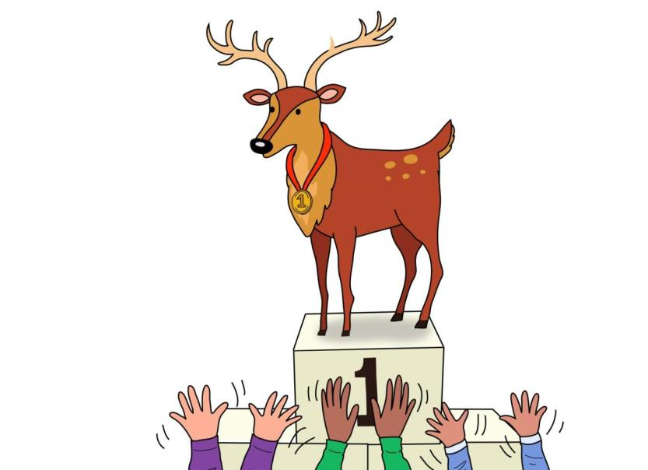
Cheer for the deer eer eer eer

Slide 46
Skip to my lou my darling

Slide 47
Now we’ve sung our song to you, you can learn to blend sounds too.

Slide 48
Blending helps you read and write so sing this song all day and night.

